Slide 1
GRK 2839 – Winter School 2023 Corpus linguistics: Fundamentals, corpus compilation & annotation
Prof. Dr. Stephanie Evert
Chair of Computational Corpus Linguistics
www.linguistik.uni-erlangen.de

Slide 2
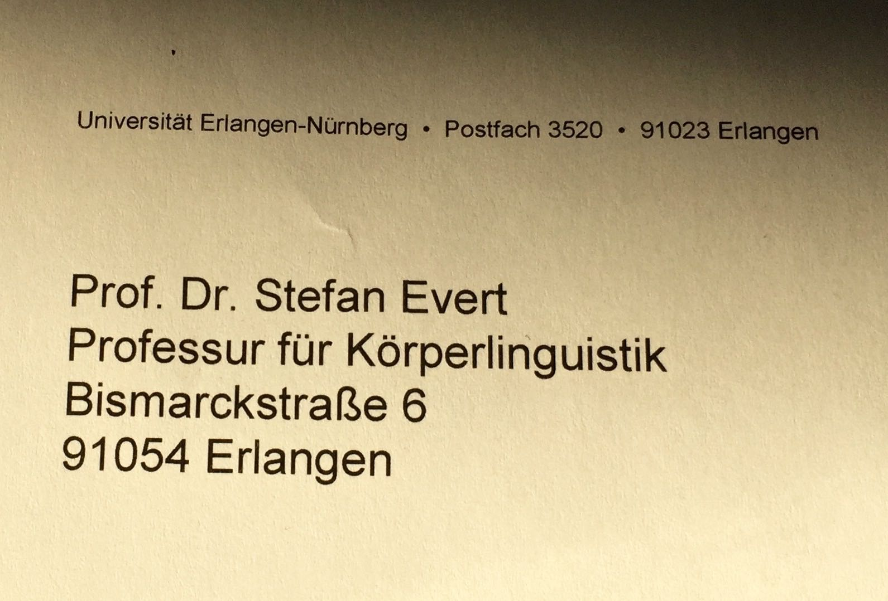
What is a corpus?

Slide 3
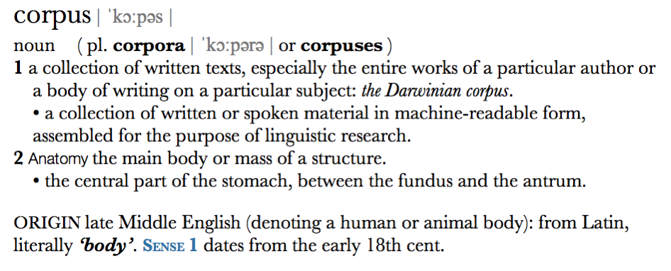
What is a corpus?
Corpus as electronic text collection (archive / database)
wide sense: common in computational linguistics & digital humanities
Corpus as representative sample of language
narrow sense: dominant in corpus linguistics (in narrow sense)

Slide 4
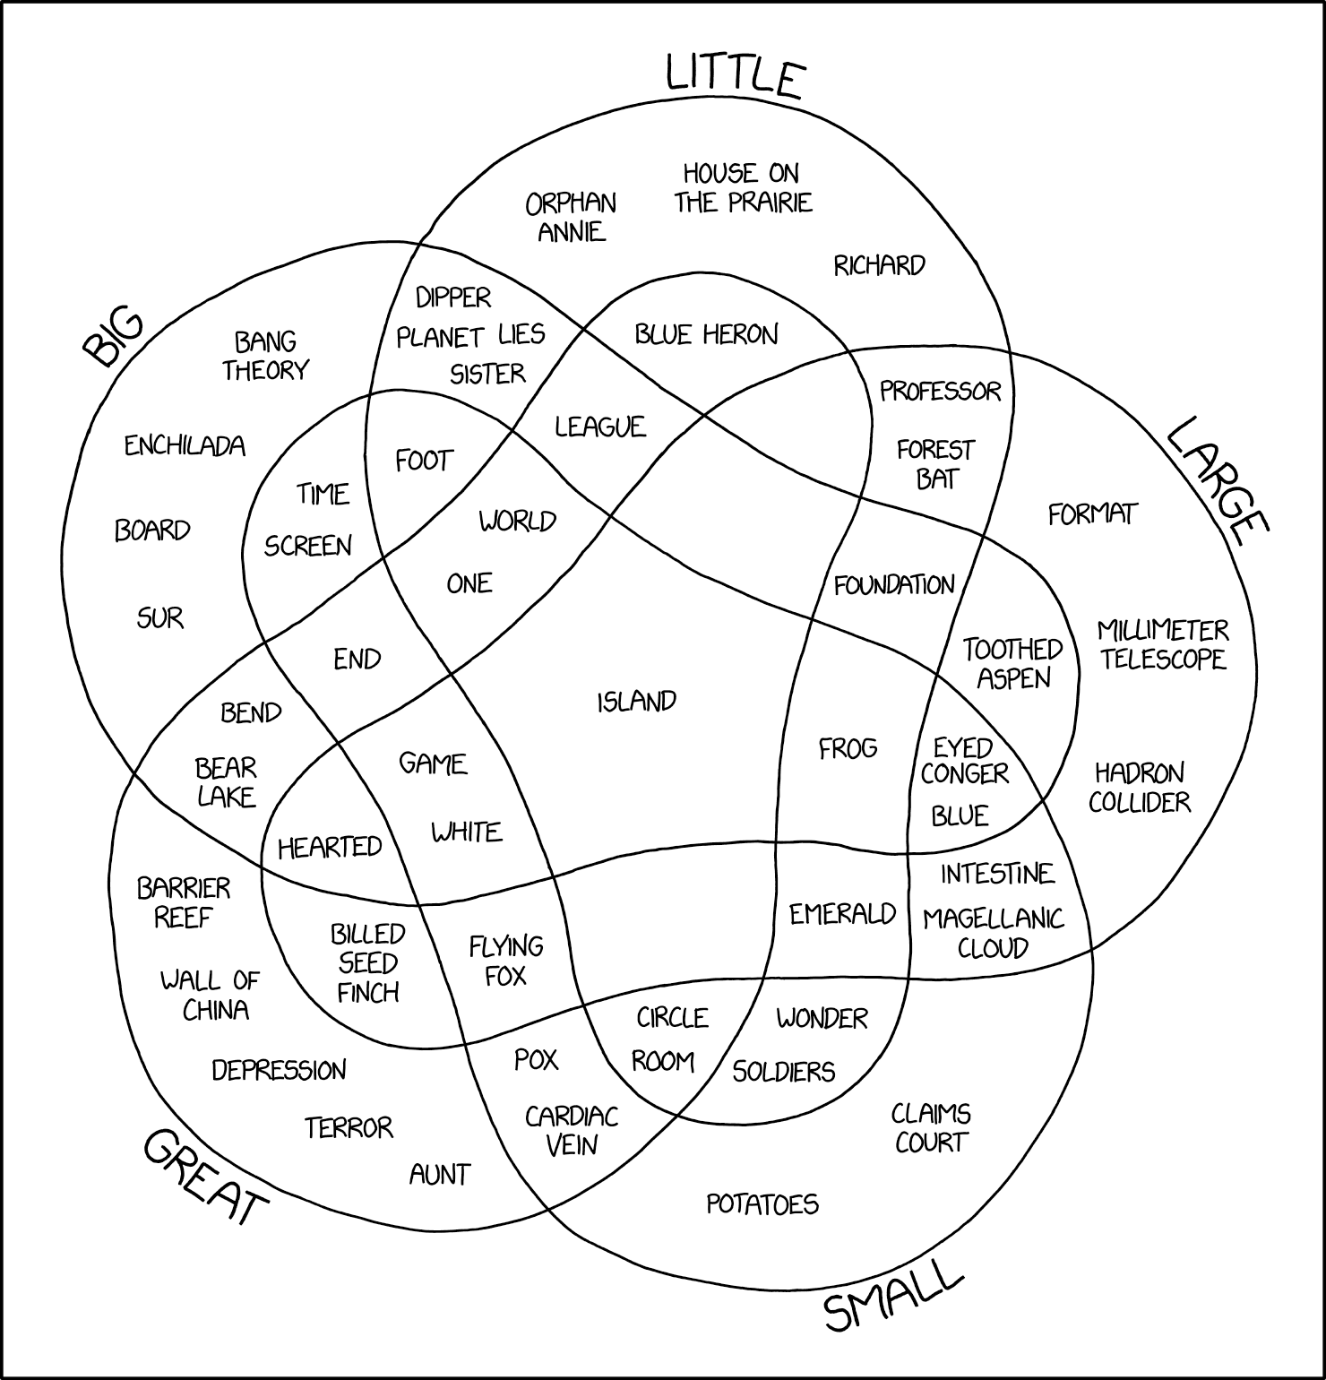
What is corpus linguistics?
In a nutshell …
The empirical scientific study of language based on authentic samples of language use
https://xkcd.com/2122/

Slide 5
What is corpus linguistics?
Corpus linguistics as a methodology
(one form of) empirical evidence for linguistic research
corpus design & practical aspects
development of software tools
quantitative analysis techniques, often in terms of frequency comparison
Corpus linguistics as discipline
concordance, collocations, keywords
language in use, not language as system
language as a medium ➞ applied CL
typical research topics
Corpus-based research
verification of hypotheses and theoretical predictions
compilation of specialised corpora
exploration of specific constructions
statistical significance of differences, data analysis as discovery procedure
Corpus-driven research
“trust the text” (Sinclair 2004)
purely empirical, inductive, contextualised
socio-political discourses & rhetoric
sociolinguistic & functional aspects language variation computational lexicography language pedagogy (➞ CALL) …

Slide 6
Corpus linguistics vs. Theoretical linguistics
Corpus linguistics
long tradition in esp. British linguistics since 1950s (Quirk, Firth, Sinclair, Leech, …)
based on corpus data, i.e. authentic language use
empiricist / inductive
patterns & preferences
frequency
“ordinary” language in use
empirical validation of theory, induction of new hypotheses
goals: language use, language as medium
Generative linguistics
mainstream of theoretical linguistics since early 1960s (Chomsky 1957)
based on introspection and grammaticality judgements
rationalist / deductive
rules
yes / no (grammaticality)
language system, border cases
theory developed on basis of individual (invented) examples
goal: cognitive account of language faculty
Notes:
• extreme Darstellung zweier gegensätzlicher Positionen
• entspricht der Situation ca. 1960–1990
• moderen Arbeiten kombinieren oft beide Ansätze: Korpusdaten werden mit Introspektion interpretiert; Theoriebildung; empirische Überprüfung

Slide 7
Pre-history of corpus linguistics
First corpus-based quantitative studies in late 19th century
Orthography and frequency lists
Käding (1897): German frequency dictionary based on corpus of ca. 11 million words (manual work!)
Language acquisition
first longitudinal studies ca. 1876–1926 (parent diaries)
large cross-sectional studies ca. 1927–1957
Lexicography
Murray: several million index cards for OED (1879–1928)
Foreign language teaching
basic vocabulary, vocabulary levels, collocations (e.g. Palmer 1933)
Strucuralist language documentation
Boas (1940), J.R. Firth (1930–1955), …
Comparative philology
Eaton (1940): semantic frequency lists for English, French, German, Spanish
Notes:
• Häufigkeitswörterbuch based on ca. 300 books analyzed by more than 665 workers, initiated by German stenographer Friedrich Wilhelm Kaeding (1843–1928)
• Oxford English Dictionary (OED) was conceived and edited by Sir James Murray (1879–1915)
• Harold Palmer (1933): 2nd Interim Report on English Collocations
• Franz Boas (1940): Race, Language, and Culture (key figure in American Anthropology)
• Helen Slocomb Eaton (1940): Semantic Frequency List for English, French, German and Spanish

Slide 8
Chomsky (1957)
Rationalism (introspection) vs. empiricism (data-oriented)
corpus linguistics: empirical description of language patterns
Chomsky: explanatory theory, must be cognitively plausible
Competence vs. performance
Chomsky: corpus reflects speaker performance (with mistakes), empirical frequency data irrelevant for language competence
counter-argument: armchair linguistics based on invented examples
Representativity
human speakers can produce infinitely many well-formed utterances; even a large corpus only contains a small subset ➞ not representative
Chomsky: “Any natural corpus will be skewed. Some sentences won't occur because they are obvious, others because they are false, …”
Learnability: the poverty of stimulus argument
corpus data insufficient for language acquisition: no negative examples
Notes:
„Then came Chomsky … and broke linguistics.“

Slide 9
Recent history of corpus linguistics
Since 1950: Humanities Computing (➞ Digital Humanities)
1950–1960: Mechanolinguistics (Juilland: contrastive corpora) ➞ quantitative / mathematical linguistics (Harris 1968)
1960–1980: Corpus linguistics as European counter-movement against mainstream of generative linguistics (➞ Chomsky)
Corpus-based grammars (e.g. Quirk/Greenbaum)
Survey of English Usage (SEU) since 1960
Brown Corpus 1961–1963
British contextualism (Firth & Sinclair)
Firth (1957) building on Malinowski & Jones, Sinclair (1991), computational lexicography (COBUILD)
principles of collocation & colligation, “trust the text”
Since 1990: Corpus linguistics established as subdiscipline of linguistics, begins to accept methodological innovations from other subdisciplines
Since 2010: Corpus evidence has become an essential part of linguistic research

Slide 10
Applications of corpus linguistics (I)
Dialectology & contrastive linguistics
Historical linguistics & language change
Language description (e.g. endangered languages)
Language teaching, language acquisition, CALL
Language variation, register studies (➞ Biber's MDA)
Lexical semantics (e.g. semantic prosodies)
Lexicography & lexicology (➞ COBUILD, collocation dictionaries)
Morphology (➞ quantitative productivity)
Phonology (esp. studies of phonological variation)
See McEnery, Xiao & Tono (2006, Unit A10) for examples and references
Notes:
Quirk/Greenbaum/Leech/Svartvik: Comprehensive Grammar of English
Biber et al.: Longman Grammar of Spoken and Written English

Slide 11
Applications of corpus linguistics (II)
Pragmatics & discourse analysis (➞ rhetoric, ideology, politics)
Psycholinguistics & psychology (e.g. frequency & association norms)
Sociolinguistics (e.g. gender studies, language ideology, power relations)
Stylometry & literary studies (e.g. authorship attribution, literary stylistics)
Syntax & grammar (➞ Quirk/Greenbaum, LGSWE)
Theoretical linguistics (➞ validation of theoretical predictions)
Translation studies (➞ “translationese”, CAT)
Usage-based linguistics (➞ cognitive linguistics, construction grammar)
See McEnery, Xiao & Tono (2006, Unit A10) for examples and references
Notes:
Quirk/Greenbaum/Leech/Svartvik: Comprehensive Grammar of English
Biber et al.: Longman Grammar of Spoken and Written English

Slide 12
The stages of a typical corpus study
Operationalization
research question ➞ quantitative hypothesis, definition of population (sampling frame)
Corpus compilation
selection of texts (from sampling frame), digitization / format conversion
collection of metadata, legal & ethical issues
shortcut: reuse existing corpus (often by selecting a suitable subcorpus)
Linguistic annotation
manual annotation, GUI, annotator agreement
automatic annotation with NLP tools for larger corpora
Representation format
standards: Unicode, XML, TEI, XCES, … important for archiving and data exchange
efficient binary index formats (e.g. CWB) for corpus search & quantitative analysis
today
Thursday
Notes:
we will look at these issues in much more detail over the next 3 sessions

Slide 13
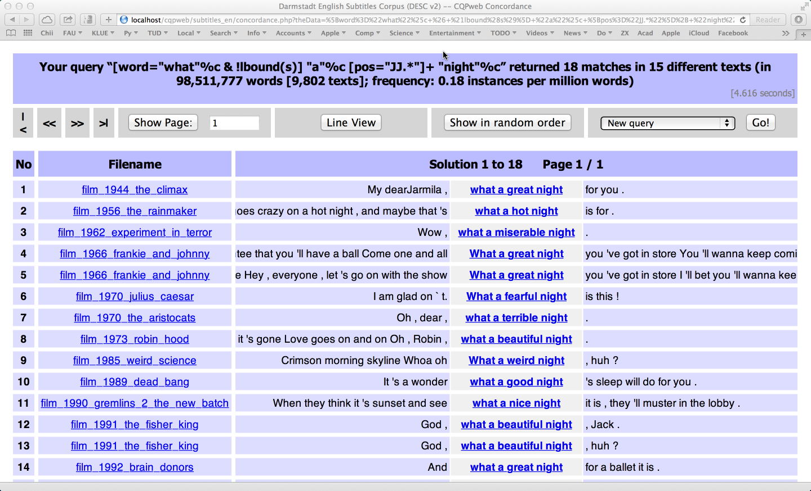
The stages of a typical corpus study
Indexing & search
search for keyword, phrase, linguistic pattern, …
view results as concordance (“kwic” = keyword in context)
analysis = grouping & structuring of concordance in order to identify recurrent patterns
efficient search based on binary index format
Quantitative analysis
many insights based on systematic analysis of frequency data (esp. for large corpora)
frequency comparison, keywords, co-occurrence
statistical hypothesis tests, data analysis, visualisation
Interpretation
tomorrow
Friday

Slide 14
Types of corpora
written vs. spoken vs. multimodal/multi-media
reference corpus vs. specialized corpus
synchronic vs. diachronic (discrete, continuous)
closed corpus vs. monitor corpus
monolingual vs. multilingual (parallel, comparable)
unannotated (raw text) vs. annotated
metadata = information about texts & speakers/authors
linguistic annotation = systematically coded interpretation
corpus size: small & clean vs. large & messy
measured in M = million (or G = billion) running words

Slide 15
Some corpora everybody should know
Brown Corpus (Francis & Kucera 1964)
American English, written (edited), texts published in 1961
500 samples @ 2000 words from 15 text genres (categories)
Brown Family
Brown (AmE, 1961), LOB (BrE, 1961) – Frown (AmE, 1991), FLOB (BrE, 1991) – BLOB (BrE, 1931), BE2006 (BrE, 2006)
Penn Treebank (Marcus, Santorini & Marcinkiewicz, 1993)
ca. 3 million words of AmE with syntactic analyses (parse trees)
British National Corpus (Aston & Burnard 1998)
British English, 90% written / 10% spoken, collected ca. 1991
approx. 100 million words in 4048 files (= texts / collections)
Web as Corpus: WaCky (Baroni et al. 2009)
ca. 2 billion words of text from automatically crawled Web pages for each of DE, EN, FR, IT
many other Web as Corpus projects: larger corpora, additional languages (Arachnea, COW, SkE 10¹⁰)
Notes:
Brown = Brown University, RI (W. Nelson Francis & Henry Kucera)
LOB = Lancaster – Oslo – Bergen
Frown/FLOB = Freiburg
BLOB = Before LOB, Lancaster
Penn Treebank = U of Pennsylvania, Philadelphia, PA
BNC first released in 1994
→ im Deutschen wesentlich schlechtere Datenlage!

Slide 16
Recommended textbooks
McEnery, Tony and Wilson, Andrew (2001). Corpus Linguistics. Edinburgh University Press, 2nd ed.
McEnery, Tony; Xiao, Richard; Tono, Yukio (2006). Corpus-Based Language Studies: An advanced resource book. Routledge, London/New York. https://www.lancaster.ac.uk/fass/projects/corpus/ZJU/xCBLS/CBLS.htm
McEnery, Tony and Hardie, Andrew (2012). Corpus Linguistics: Method, Theory and Practice. Cambridge University Press, Cambridge.
Lüdeling, Anke and Kytö, Merja (eds.) (2008). Corpus Linguistics. An International Handbook. Mouton de Gruyter, Berlin.
Kennedy, Graeme D. (1998). An Introduction to Corpus Linguistics. Longman (Pearson Education Ltd), London and New York.
Hoffmann, Sebastian et al. (2008). Corpus Linguistics with BNCweb – a Practical Guide, vol. 6 of English Corpus Linguistics. Peter Lang, Frankfurt.
Lemnitzer, Lothar and Zinsmeister, Heike (2015). Korpuslinguistik: Eine Einführung. Narr, Tübingen, 3rd edition.

Slide 17
Research community
Important conferences
Corpus Linguistics (Lancaster / Birmingham / UK)
ICAME = International Computer Archive of Modern and Medieval English
AACL = American Association for Corpus Linguistics
CILC = International Conference on Corpus Linguistics
Scientific journals
International Journal of Corpus Linguistics (IJCL)
Corpora
ICAME Journal
Corpus Linguistics and Linguistic Theory (CLLT)
Web resources
David Lee's bookmarks (maintained by Martin Weisser): http://tiny.cc/corpora (navigation: CBL Links)
Linguistics Web (Sabine Bartsch): http://www.linguisticsweb.org/

Slide 18
Corpus design

Slide 19
What is representativeness?
representative random sample
population
(of “objects”)
Statistics (hypothesis tests)
corpus data
(frequencies)
operationalized
hypothesis
about “language”
linguistic research question
Notes:
Recall the first steps / design of a corpus study
Conclusion: corpus should be a representative sample of the “language” to be studied in the sense of a statistical random sample

Slide 20
Goals of corpus design
Representativeness
a corpus should be representative of the (sub-)language to be studied
statistics: random sample
full representativeness difficult to achieve
must at least be balanced (= good coverage of different registers, speakers, …)
and avoid bias or skew towards any particular group of speakers, text type, topic, …
Comparability
corpus linguistic analysis often builds on frequency comparison between different corpora or sub-corpora
prerequisite: comparable corpora

Slide 21
Representativeness & sampling
Statistics: completely random sample
extensional population of interest, i.e. a (possibly infinite) collection of objects
randomly select n objects from population
But what about language?
Design criteria ➞ sampling frame
dices up and defines linguistic population ➞ make relevant texts identifiable
“A sampling frame is an operational definition of the population, an itemized listing of population members from which a representative corpus can be chosen.” (Biber 1993, 244)
pick specified number of items from each cell (related to stratified sampling)
language
spoken
written
sampling frame
Notes:
sampling frame dices up linguistics population based on metadata categories
e.g. spoken vs. written; age group of speaker/author; text type / genre; …
categories often “orthogonal” to each other, but sometimes different subdivisions (e.g. text type | mode)
find specified number of available text for each cell of the grid ➞ ensures balance, approximates random sampling

Slide 22
Representativeness & sampling
Definition of a sampling frame
fundamental distinctions: mode (spoken/written/written-to-be-spoken), medium
text characteristics: (publication) date, author (single/multi/anon), region, target audience, …
function of text: genre / text type (factuality, purpose, situation, …), topic domain, …
properties of author/speaker: sex, age, dialect, social class, …
see Atkins et al. (1992) for a comprehensive system of categories
Balance
include texts from all (combinations of) categories in the sampling frame = grid cells
avoids bias/skew ➞ balanced coverage of the “language” population
Representativeness
sampling frame makes population identifiable (for each combination of categories) ➞ random selection of texts for each cell
must specifiy proportion of texts to be sampled from each category = prevalence in language

Slide 23
Further reading
Atkins, Sue; Clear, Jeremy; Ostler, Nicholas (1992). Corpus design criteria. Literary and Linguistic Computing, 7(1), 1–16.
Biber, Douglas (1993). Representativeness in corpus design. Literary and Linguistic Computing, 8(4), 243– 257.
HSK 29.1 Corpus Linguistics, Art. 9
HSK 5.4 Dictionaries: Computational Lexicography, Art. 96 (Ch. XVIII)

Slide 24
Brainstorming
How would you design a corpus for a study of evaluative language in music reviews?
… or another research question?

Slide 25
Annotation

Slide 26
A corpus consists of …
Object data = texts
primary data, main object of analysis
Metadata = information about the texts
title, author, publication date, text type, medium, …
age, sex, education, region, dialect, … of authors
always include all variables used to define sampling frame
Typographic markup & text structure
paragraphs, headings, bold/italics, typeface, itemized lists, footnotes, …
Annotation = linguistic interpretation
simple (token level) vs. structured (e.g. syntax tree)
essential for querying and analyzing large corpora

Slide 27
Corpus annotation: raw text + metadata
It seemed a day much as any other until I happened to look out of the back window. There was a little garden behind the house; a well-mown lawn surrounded by a neatly cut hedge, a few bushes and colourful flowers.
metadata
title: The Garden
author: Stefan Evert
author sex: male date: 05.08.1991

Slide 28
Corpus annotation: tokenization
It seemed a day much as any other until I happened to look out of the back window . There was a little garden behind the house ; a well-mown lawn surrounded by a neatly cut hedge , a few bushes and colourful flowers .

Slide 29
Corpus annotation: sentence segmentation
<s> It seemed a day much as any other until I happened to look out of the back window . </s>
<s> There was a little garden behind the house ; a well-mown lawn surrounded by a neatly cut hedge , a few bushes and colourful flowers . </s>

Slide 30
Corpus annotation: part-of-speech (POS) tagging
<s> It_{PP} seemed_{VBD} a_{DT} day_{NN} much_{RB} as_{IN} any_{DT} other_{JJ} until_{IN} I_{PP} happened_{VBD} to_{TO} look_{VB} out_{RP} of_{IN} the_{DT} back_{JJ} window_{NN} ._{SENT} </s>
<s> There_{EX} was_{VBD} a_{DT} little_{JJ} garden_{NN} behind_{IN} the_{DT} house_{NN} ;: a_{DT} well-mown_{VBN} lawn_{NN} surrounded_{VBN} by_{IN} a_{DT} neatly_{RB} cut_{VBN} hedge_{NN} ,, a_{DT} few_{JJ} bushes_{NNS} and_{CC} colourful_{JJ} flowers_{NNS} ._{SENT} </s>

Slide 31
English: Penn tagset * with TreeTagger-internal modifications
*
*
*
*
*
*
*
*
*
*
*
*
*

Slide 32
German: STTS tagset

Slide 33
Manual annotation
Manual annotation for small, high-quality corpora
e.g. digital edition, political speeches, poetry/song texts, …
Annotation schema and categories
Guidelines = detailed instructions for annotators
plus collection of examples for unclear / difficult cases
Annotation tools (usually Web-based)
e.g. INCEpTION (https://inception-project.github.io), Prodigy (https://prodi.gy)
Inter-Annotator Agreement (IAA)
reliability and validity of the annotation
annotator mistakes vs. systematic differences
Notes:
Reliabilität = Mess- bzw. Annotationsfehler
Validität = Aussagekraft bzw. Messbarkeit, wird durch systematische Differenzen in Frage gestellt

Slide 34
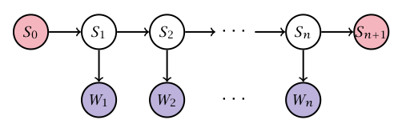
Automatic annotation
Most successful approach: machine learning
Need to cast annotation as classification task
Gold standard = corpus with manual annotation
annotation must be consistent, errors seem unproblematic
separate into training, development and test data
Example: tagging with Hidden Markov Model (HMM)
see e.g. Brants (2000), Schmid (1995)
(Evert et al. 2009)

Slide 35
Corpus annotation: lemmatization
<s> It_{PP} seemed_{VBD} a_{DT} day_{NN} much_{RB} as_{IN} any_{DT} other_{JJ} until_{IN} I_{PP} happened_{VBD} to_{TO} look_{VB} out_{RP} of_{IN} the_{DT} back_{JJ} window_{NN} ._{SENT} </s>
<s> There_{EX} was_{VBD} a_{DT} little_{JJ} garden_{NN} behind_{IN} the_{DT} house_{NN} ;: a_{DT} well-mown_{VBN} lawn_{NN} surrounded_{VBN} by_{IN} a_{DT} neatly_{RB} cut_{VBN} hedge_{NN} ,, a_{DT} few_{JJ} bushes_{NNS} and_{CC} colourful_{JJ} flowers_{NNS} ._{SENT} </s>

Slide 36
Corpus annotation: lemmatization
<s> It_{PP}^{it} seemed_{VBD}^{seem} a_{DT}ª day_{NN}^{day} much_{RB}^{much} as_{IN}^{as} any_{DT}^{any} other_{JJ}^{other} until_{IN}^{until} I_{PP}^{I} happened_{VBD}^{happen} to_{TO}^{to} look_{VB}^{look} out_{RP}^{out} of_{IN}^{of} the_{DT}^{the} back_{JJ}^{back} window_{NN}^{window} ._{SENT}. </s>
<s> There_{EX}^{there} was_{VBD}^{be} a_{DT}ª little_{JJ}^{little} garden_{NN}^{garden} behind_{IN}^{behind} the_{DT}^{the} house_{NN}^{house} ;:; a_{DT}ª well-mown_{VBN}??? lawn_{NN}^{lawn} surrounded_{VBN}^{surround} by_{IN}^{by} a_{DT}ª neatly_{RB}^{neatly} cut_{VBN}^{cut} hedge_{NN}^{hedge} ,,, a_{DT}ª few_{JJ}^{few} bushes_{NNS}^{bush} and_{CC}^{and} colourful_{JJ}^{colorful} flowers_{NNS}^{flower} ._{SENT}. </s>
need better representation format

Slide 37
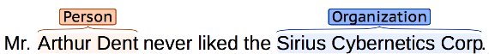
Corpus annotation: segments and structures
Automatic recognition and categorization of particular word sequences (segments)
e.g. named entities (NER = named entity recognition)
e.g. time and place expressions: last week, the day after tomorrow, September 15th, in Paris, on the lawn in front of their house, …
e.g. text spans that need to be masked for anonymization purposes

Slide 38
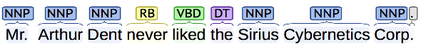
Corpus annotation: segments and structures
Syntactic phrase structure analysis = parse tree of nested segments corresponding to syntactic units
„minimal“ phrases as flat segments ➞ chunk parsing
S
VP
NP
AdvP
NP

Slide 39
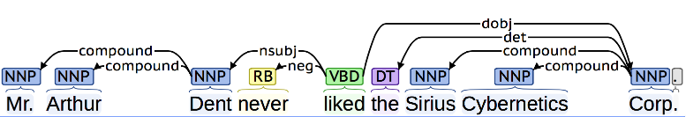
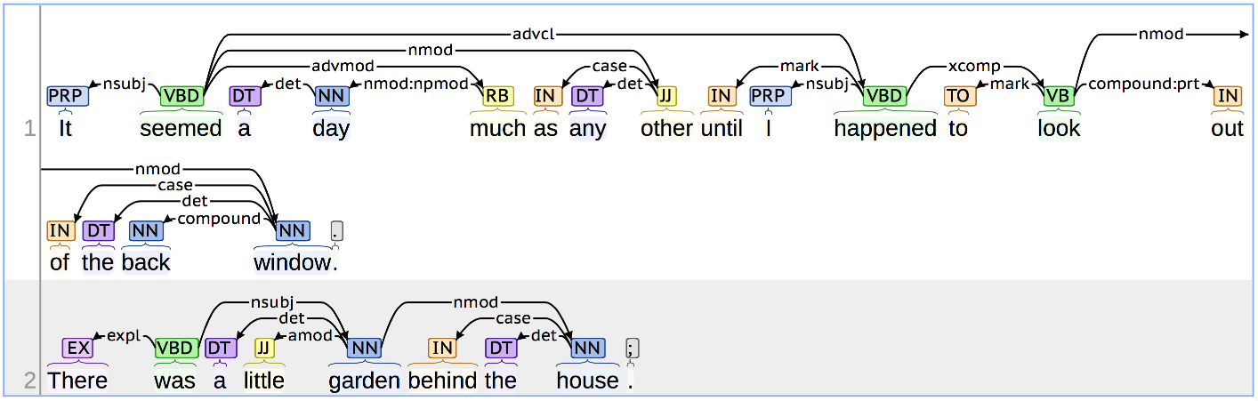
Corpus annotation: syntactic dependency analysis
Try it for yourself at http://corenlp.run/

Slide 40
Sentence alignment for parallel corpora
Das stört mich keineswegs, ich halte das für eine gute Initiative, aber wiederum ist Europa nicht zur Stelle. | That is no problem for me.
 | I think it is a good initiative, but again Europe is absent.
Es darf nicht wieder geschehen! | It should not happen again, Mr President.
Meine Fraktion verlangt, daß die italienische Präsidentschaft hier vor uns erklärt, welche Rolle sie spielt. | My Group wants the Italian presidency to come here and explain what its role is.
Herr Präsident, liebe Kolleginnen und Kollegen! | Mr President, ladies and gentlemen, I think it is important that we should discuss the situation in the Middle East this week.
Ich halte es für wichtig, daß wir diese Woche über die Situation im Nahen Osten reden.
Darin sind wir uns alle einig. | We all agree on that.
Notes:
• Satzalignment = Sätze werden ihren Übersetzungen zugeordnet (in einem Paralleltext)
• I.d.R. wird Alignment vom Übersetzer nicht explizit markiert ➔ muss mit automatischem Verfahren bestimmt werden

Slide 41
Sentence alignment: bitext map
E6 |  |  |  |  |  | ■
E5 |  |  |  | ■ | ■
E4 |  |  | ■
E3 |  | ■
E2 | ■
E1 | ■
 | D1 | D2 | D3 | D4 | D5 | D6
Notes:
• Ansatz: Berechnung von Satzähnlichkeiten (Länge, Eigennamen und Zahlen, bekannte Übesetzungsäquivalente, orthographisch ähnliche Wörter, Wortarten, …)
• dann Suche nach sehr ähnlichen Sätzen in der Nähe der Diagonalen

Slide 42
Sentence alignment as similarity search
E6 |  | ■ |  |  |  | ■
E5 | ■ |  |  | ■ | ■
E4 |  |  | ■ |  | ■
E3 |  | ■ |  | ■
E2 | ■ |  |  | ■
E1 | ■ | ■ |  |  |  | ■
 | D1 | D2 | D3 | D4 | D5 | D6
Notes:
• Ansatz: Berechnung von Satzähnlichkeiten (Länge, Eigennamen und Zahlen, bekannte Übesetzungsäquivalente, orthographisch ähnliche Wörter, Wortarten, …)
• dann Suche nach sehr ähnlichen Sätzen in der Nähe der Diagonalen

Slide 43
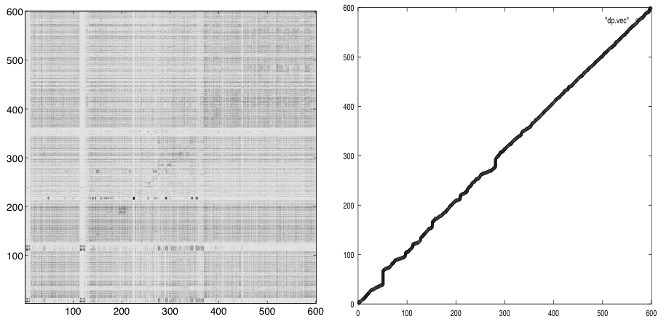
Sentence alignment as similarity search

Slide 44
Thank you for listening!

